Slide 1
ESP KPI Tracker Update
Jan 5 2026

Slide 2
Project Timeline & Key Milestones
Wayne
Feb 2023 Kickoff
Feb 2025 Prod
Jan 2026 Vendors
Mar 2026 Complete
Delays:
  Resourcing constraints
  Shifting organizational priorities
  UAT testing extensions
  Team reassignments
Upcoming Milestones:
  Vendor onboarding: Jan 2026
  Project completion: Mar 2026

Slide 3
What’s Been Completed & What’s Next
Wayne
Completed Work
  Core UI, database and ETL delivered in Feb 2025
  Data optimized and reporting dashboards launched
  Change requests addressed (this will be expanded on in later slides)
Current Focus
  Integration with external vendors
  Ongoing user adoption and training
  Visualization development
Upcoming Tasks
  Next round of visualizations
  System stabilization and scaling

Slide 4
Roadmap (OLD SLIDE – WG – See New Slide 5)
Shane
What is happening in Q1?
  User adoption and integration
    Training and User manual
      ENI Eng, Field, Prod Eng and vendors – Jan
      Compliance and utilization – PWA and DB
  2026 quote, design and everything is loaded into ESP KPI
  Vendor access and everything approved Jan 1 – actually entering data
Highlight key milestones
Key Transition Milestones:
  User training
  Data backfill completion
  Change management actions
  Stakeholder communications

Slide 5
Q1 2026: Transition & Go-Live Activities
Shane
Focus:
  Full user adoption & system integration
  Training completion & user manual distribution
  Onboard ENI Eng, Field, Prod Eng, vendors (Jan)
  2026 quotes/design/data loaded into ESP KPI
  Vendor data entry begins Jan 2026
Key Transition Milestones:
  Finish data backfill
  Execute change management plan
  Compliance & utilization tracking live (PWA/DB)
  Stakeholder communications sent

Slide 6
2025 Development & Testing Achievements
Erika
User Acceptance Testing (UAT)
  Completed 6 sessions with internal user groups
  Logged and implemented ~50 enhancements
Beta Testing
  Conducted 3-week beta program
  Logged and implemented ~25 additional enhancements
Notes:
In 2025, we conducted extensive testing across all internal user groups. Feedback was overwhelmingly positive, and we identified approximately 75 minor enhancements. These included adjustments to field labels, units of measurement, and field ordering to improve usability and workflow. All requested changes were prioritized and successfully implemented, ensuring a smoother user experience.

Slide 7
2025 Development Achievements & Demo
Erika
External-Facing Application Security
  Secured PWA with PingID (CNRL standard sign-in)
  Preserved data integrity via automated form locking for vendors
  Restricted form access and editability by user role
User Experience Improvements
  Streamlined workflow for adding equipment installs to a Production Period
  Added data-loss prevention features with easy rollback options
  https://devapp.cnrl.com/espkpitracker/
  https://desktop.pingone.com/cnrl/Selection?cmd=selection
Notes:
Following UAT, we focused on improving workflows—particularly the process of adding new part numbers, equipment, and then installing them in a production period. These changes significantly reduced complexity and improved efficiency.
We also addressed a major pain point: accidental data loss. Users now receive prompts if they attempt to leave without saving, and we introduced a persistent master save button that is always visible, making it easy to locate and use. These enhancements provide a safety net and improve overall usability.

Slide 8
2025 Features & Demo (Part 2)
Erika
File Downloading Functionality
  Added printable versions of forms for offline data capture
  Standardized layout to align with PWA flow
Advanced Admin Functions
  Enabled front-end management of dropdown lists
  Eliminated need for IS involvement in routine updates
Notes:
We introduced printable versions of the forms to allow users to capture required data offline and then easily transfer it into the PWA. These forms mirror the PWA layout to maintain consistency and reduce errors. To further guide users, we added color-coded sections indicating responsibility for each data field.
Additionally, we built advanced admin functionality, including a dropdown management tab. This empowers the business to manage and update dropdown lists directly from the front end—without requiring IS support—giving teams more flexibility and control.

Slide 9
2025 Data Integration Achievements
Emily
ETL Status
  Complete through October 9th
  Supporting Data Added
    Part number descriptions
    CNRL equipment inventory
Data Cleanup
  Validated and standardized spreadsheet data before and during ETL
  Corrected nonstandard values to ensure consistency
Reporting Views
  KPI tracker views available for dashboard creation
  Collaborated with Cam and Shane to resolve data inconsistencies
Notes:
Our ETL process is now complete through October 9th, ensuring that all critical data is up to date. We’ve added supporting datasets, including part number descriptions and CNRL’s full inventory of equipment, to enhance reporting accuracy.
Before and during ETL, we performed rigorous data cleanup—validating spreadsheets, standardizing formats, and correcting nonstandard values. This proactive approach minimized errors and improved overall data integrity.
To support reporting, KPI tracker views are now available for dashboard creation, giving teams real-time visibility into key metrics. We also collaborated closely with Cam and Shane to resolve data inconsistencies, ensuring a reliable foundation for analytics and decision-making.

Slide 10
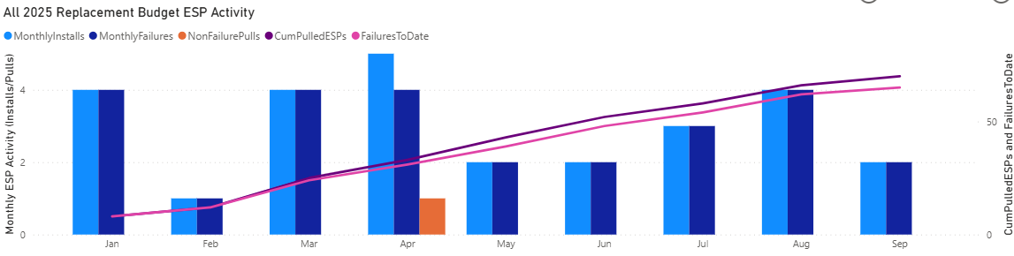
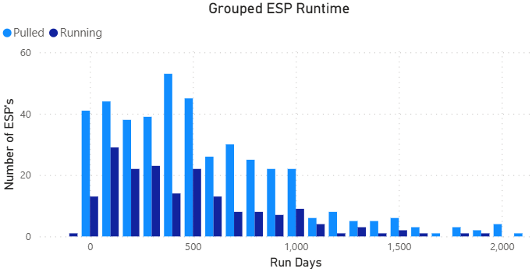
Dashboard Features
Cam
Monthly Reporting
  WKO/Equipment costs
  Activity compared to budget
Reliability Benchmarking
  Run life
  Reliability stats
  Survival curve
Leading ESP Failures
  Component
  Vendor
  Cause of failure

Slide 11
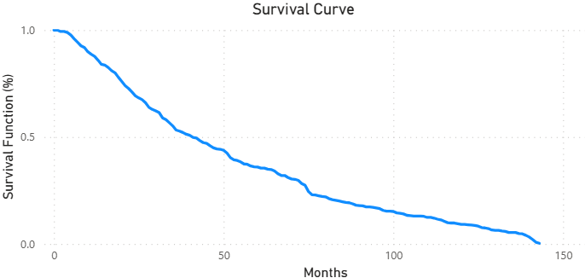
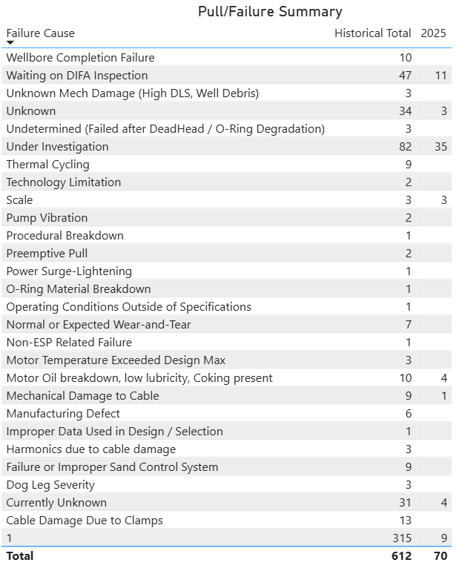
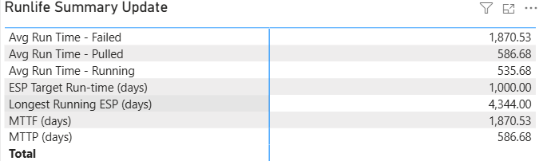
Visuals Overview
Cam
​
PowerBi Dashboard

Slide 12
Challenges – Report Development
Cam
Dashboard
  Improving small details on the dashboard
    Linking slicers to correct visualizations without affecting others
  Making dashboard more intuitive for users
Data
  Data is not up to date for everything, so it is hard to see if the dashboard and background calculations are working
Time
  Gaining experience using PowerBi takes extra time

Slide 13
Next Steps – Report Development
Cam
Refine and publish current dashboard
  Add budget info to applicable charts
Current dashboard suggestions
  Shroud reliability monthly update dashboard
  Be able to select a certain well and give all history of ESP data such as type/run time/install and pull dates/failure reason
Continue to make more dashboards based on
  ESP tracker excel sheet
  Suggestions from others

Slide 14
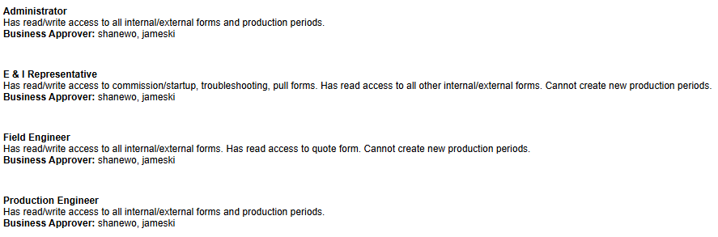
CNRL User Adoption Update
Shane

Slide 15
Data (OLD SLIDE – WG – See New Slide 16)
Shane
Business rules
Backfilling
Data Scope
    Acquire and integrate key operational and KPI data
    Clean and validate data for accuracy and completeness
    Apply business rules for consistent reporting
    Backfill historical records as required
    Ensure data readiness for dashboards and visualizations

Slide 16
Data Scope & Quality Initiatives
Shane
Acquire & integrate operational/KPI data
Clean and validate for accuracy/completeness
Apply business rules for consistency
Backfill historical records as needed
Ensure dashboard/reporting readiness

Slide 17
2026 Next Steps: Web Input Forms & Expansion
Wayne
Commercial adoption & rollout
Continuous improvement from vendor/field feedback
Product evolution and feature growth
  Expand visualization and reporting capabilities
  Look at mobile access and enhanced input forms
  Investigate predictive analytics and automation

Slide 18



ESP KPI Tracking Project –Feb 2025
Wayne
Web Input Forms
Oracle
Tableau/PowerBi
Excel
VP / Manager
Vendor Entry
Reports
Quarterly: Presentation
CNRL Entry
Field and
Calgary
Database
Q/C.
Monthly: Report 1-page
Analytics
⋮
Specials: Budget Report 1-page
20%
90%
95%
50%
Existing Excel Tool
ETL
ETL: Extract/Transform/Load
using Stored Procedure/Knime
75%
Project Overview to Show Major Areas of Development

Slide 19
ESP KPI Tracking Project – Dec 2025
Wayne
Web Input Forms
Oracle
PowerBi
Excel
VP / Manager
Vendor Entry
Reports
Annual: Presentation
Completed Using Excel
CNRL Entry
Field and
Calgary
Database
Q/C.
Monthly: Report 1-page
Analytics
95%
⋮
Budget Report 1-page
Shroud 1-page
25%
Completed Using Excel
98% (vendor) +
Enhancements
100%
80%
Existing Excel Tool
ETL
ETL: Extract/Transform/Load
using Stored Procedure
100%
Project Overview to Show Major Areas of Development

